Slide 1

Difficulty

Slide 2
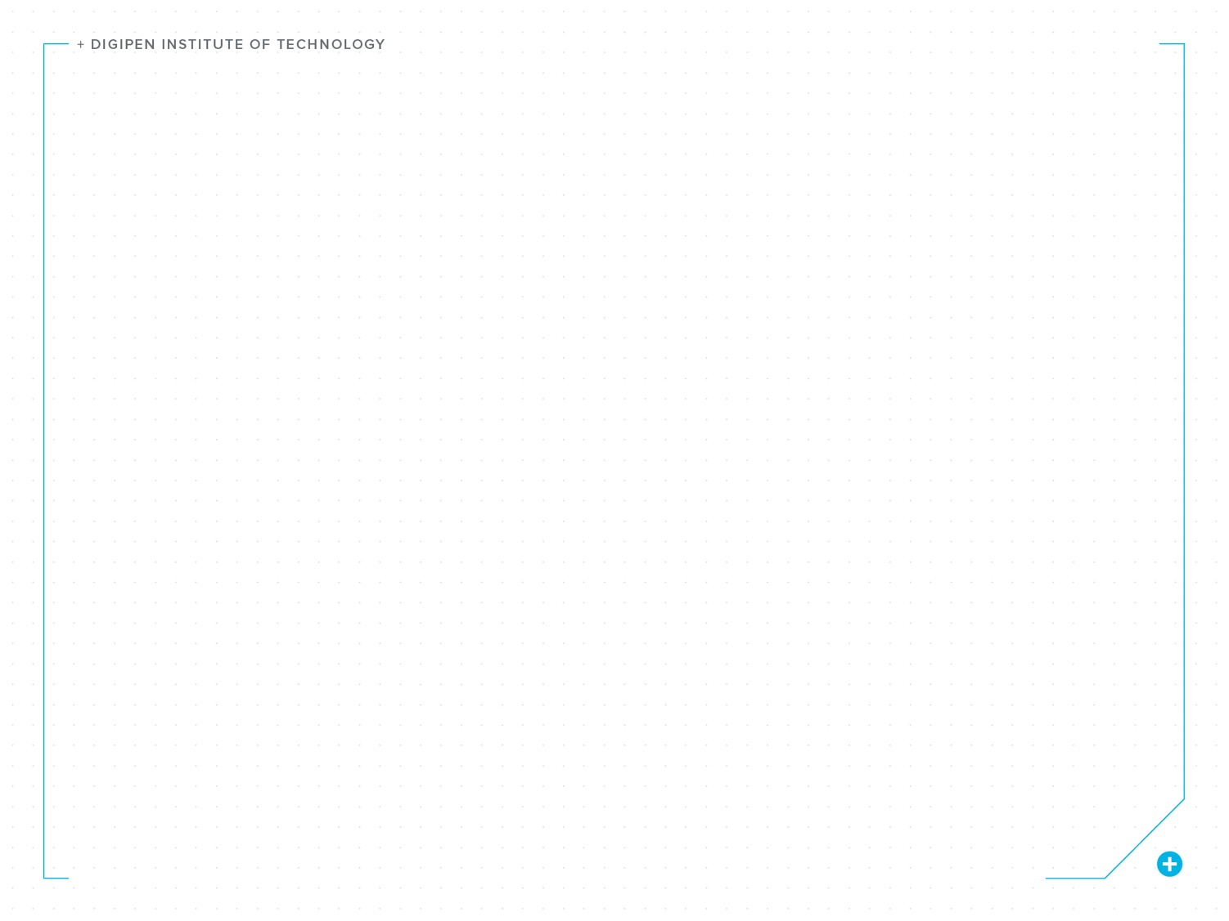
Difficulty and Challenge
In a traditional challenge-based game, the difficulty is the primary driver of the tension the player feels.

Slide 3
Difficulty and Challenge
When done properly, this tension drives the player’s engagement.

Slide 4
Difficulty Drives Tension
The chance of success or failure
(the difficulty) builds anticipation, which combined with rewards or punishments (the stakes),
creates tension.

Slide 5
Difficulty Drives Tension
If a player fails multiple times,
the anticipation will build, as long
as they feel they are getting closer and closer to succeeding.

Slide 6
Bad Tension
This often means punishments
need to be small (especially if
the chance of failure is high),
or it will feel unfair and lead
to bad tension.

Slide 7
Bad Tension
Failing in a way that the player
does not think is their fault will almost always result in bad
tension and undermine (if not destroy) engagement.

Slide 8
Skill Level
The amount of tension created by
a challenge is highly dependent
on the player’s skill level.

Slide 9
Skill Level
The tension can be too high for a
low skill player, but it can also be
too low for a high skill player.

Slide 10
Difficulty Settings
Difficulty settings, dynamic difficulty systems, gradually increasing character abilities, and secret knowledge or high skill shortcuts, are ways to deal with this problem.

Slide 11
Increasing Skill
To complicate things even more,
the player’s skill will increase over time while playing the game.

Slide 12
Flow
Maintaining the proper amount of tension while a player’s skill increases is called “flow”.

Slide 13
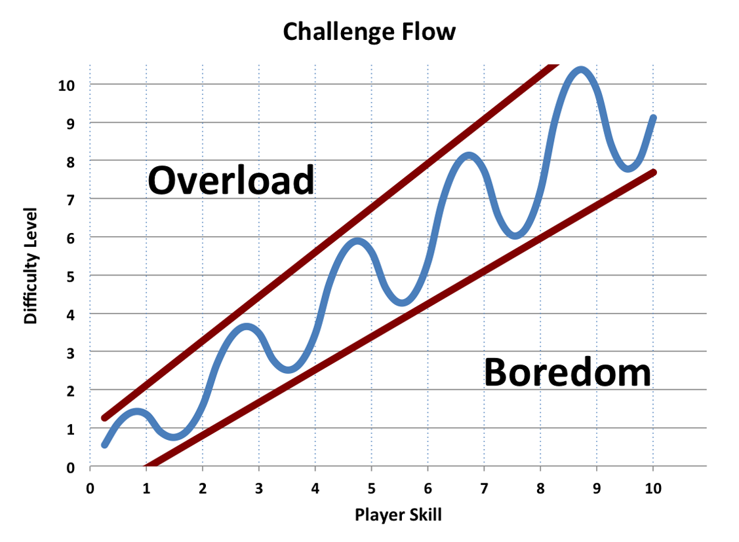

Slide 14
The relative difference between difficulty and skill
is the tension.

Slide 15
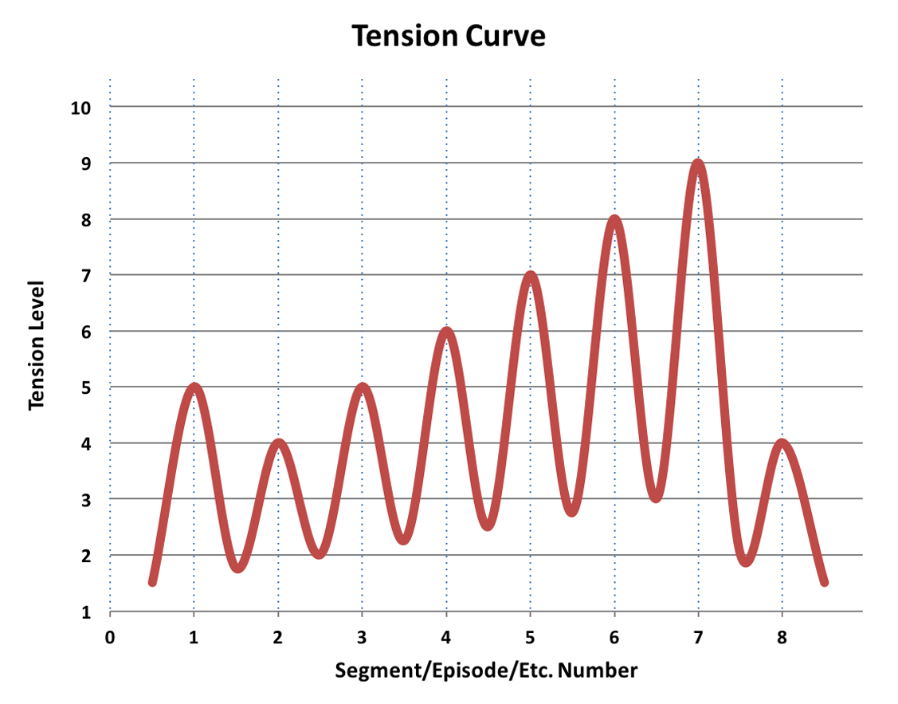

Slide 16
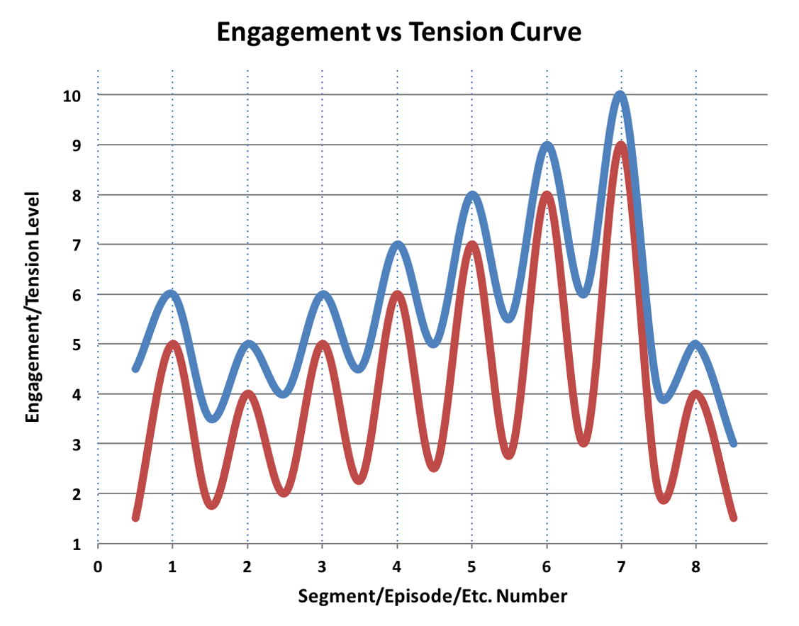

Slide 17
Build and Release
The relative difference between
the difficulty and the player’s
skill must go up and down
(and not too high or too low).

Slide 18
Build and Release
A continuous ramping up of difficulty, with no drops in
difficulty, will not create flow and
will not maximize engagement.

Slide 19
Techniques
Easy: one attempt
Medium: two attempts
Hard: three attempts
Insane: four to five attempts

Slide 20
Techniques
Easy, Easy, Medium
Easy, Easy, Medium
Easy, Easy, Hard

Slide 21
Techniques
Keep controls simple and increase complexity through new abilities, new enemies, new obstacles, and new combinations thereof.

Slide 22
Techniques
Introduce complexity gradually
and carefully over time.

Slide 23
Techniques
Provide many optional practice opportunities (that are interesting and not punishing).

Slide 24
Techniques
Provide challenge modes, optional high-difficulty paths, and access to difficult challenges early on.

Slide 25
Techniques
Provide better equipment or
abilities just for trying, so that
their character gets better even
if the player doesn’t.

Slide 26
Challenge Not Required
This does not mean you have to make a challenge-based game.

